Slide 1
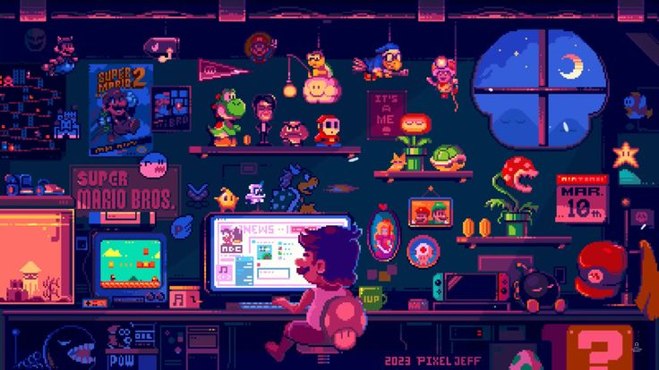
Snappy Snake
Present by Tuan Q. Tran
from GEx 2025

Slide 2
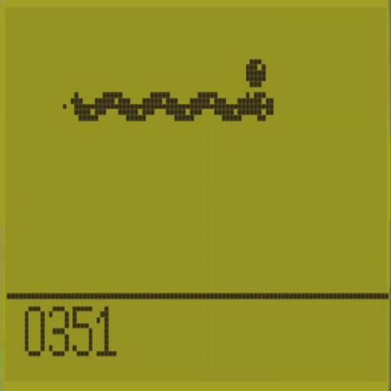
What is snake game?
According to Wikipedia, Snake is a genre of action video games where the player maneuvers the end of a growing line, often themed as a snake. The player must keep the snake from colliding with both other obstacles and itself, which gets harder as the snake lengthens.
It will be 2D, pixel and top down.
Anyone can play

Slide 3
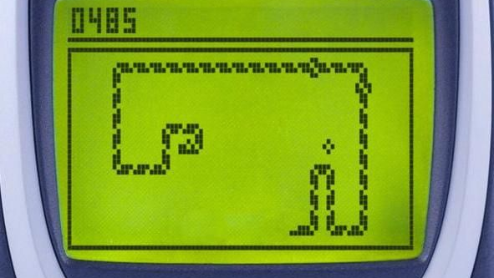
Why Snappy Snake?
It is a classic game. I played the game repeatedly on a Nokia phone with physical buttons.
2. The game has simple mechanics with deep engagement. The 6-directional movement adds a layer of complexity.
3. Pixel art is a timeless, versatile art style that resonates with a wide audience.
4. The combination of retro design, challenging movement mechanics, and varying objectives ensures players return for more.
5. Developing this game allows me to hone my programming, game design, and pixel art skills.

Slide 4
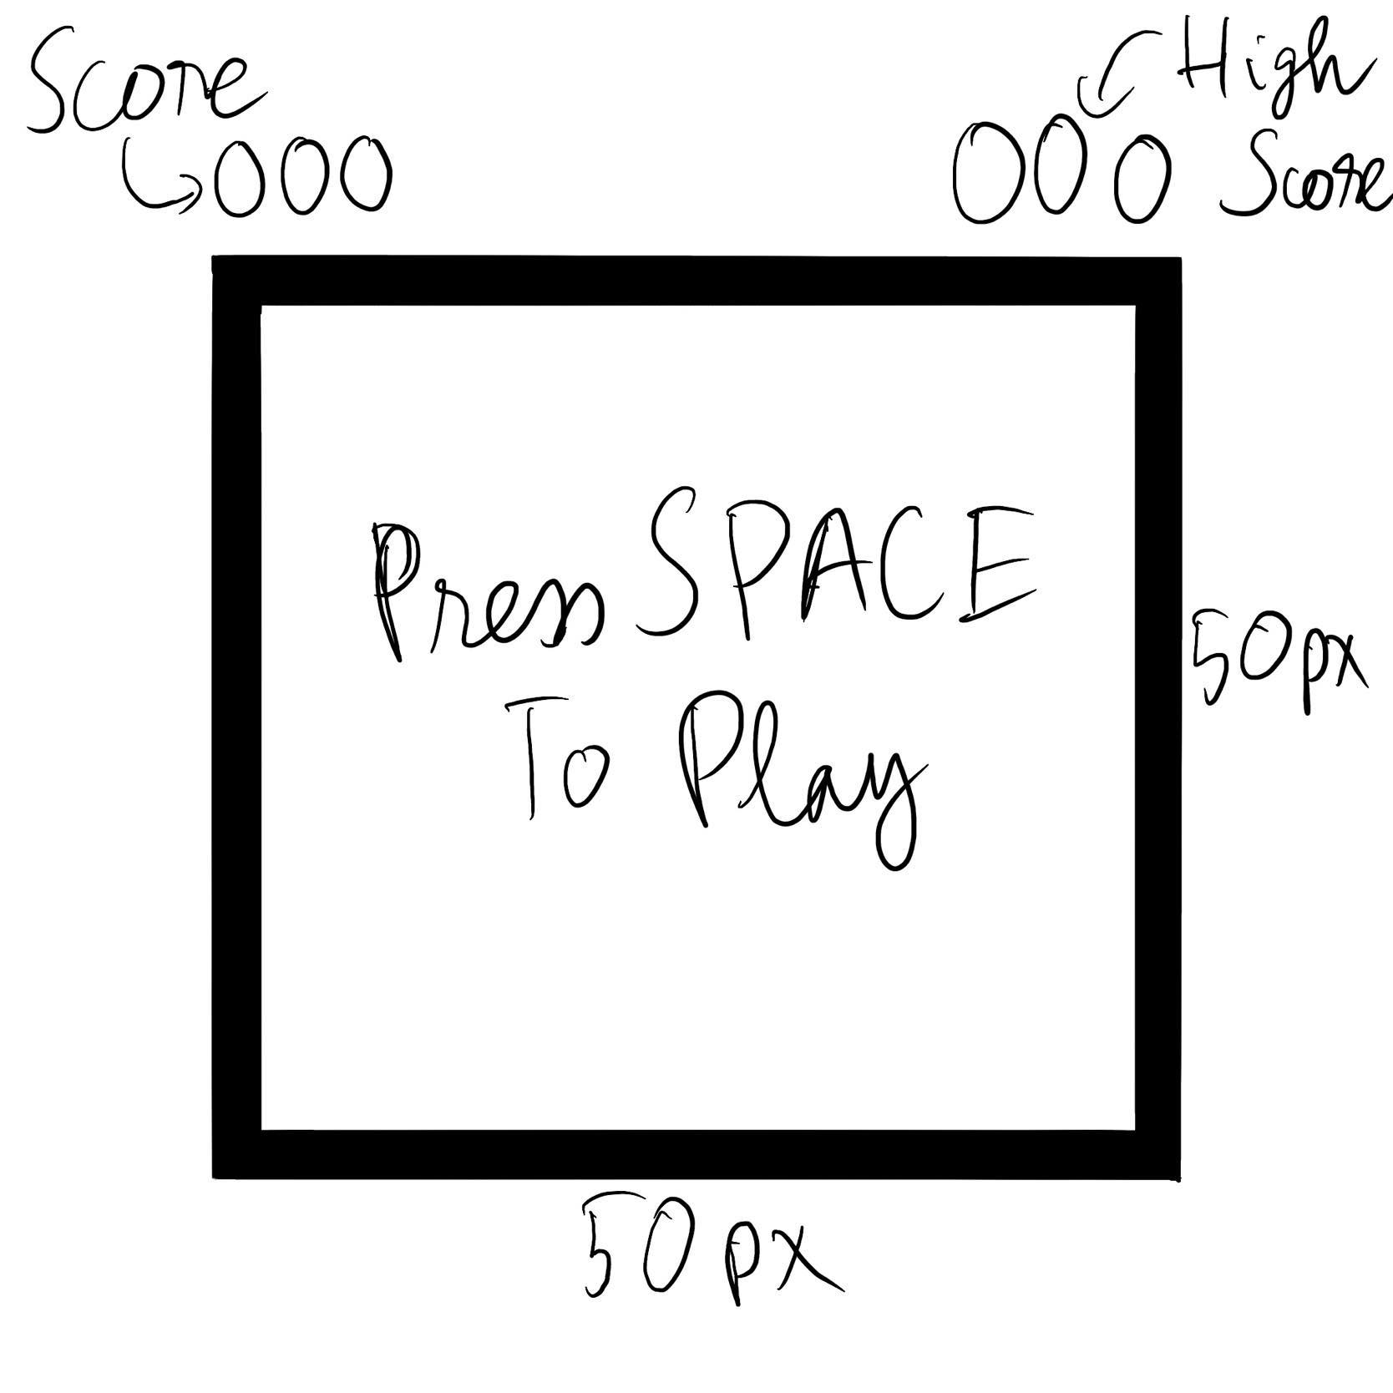

Slide 5
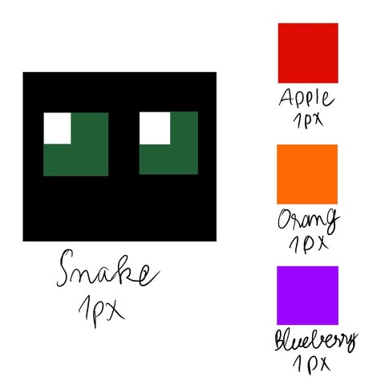

Slide 6
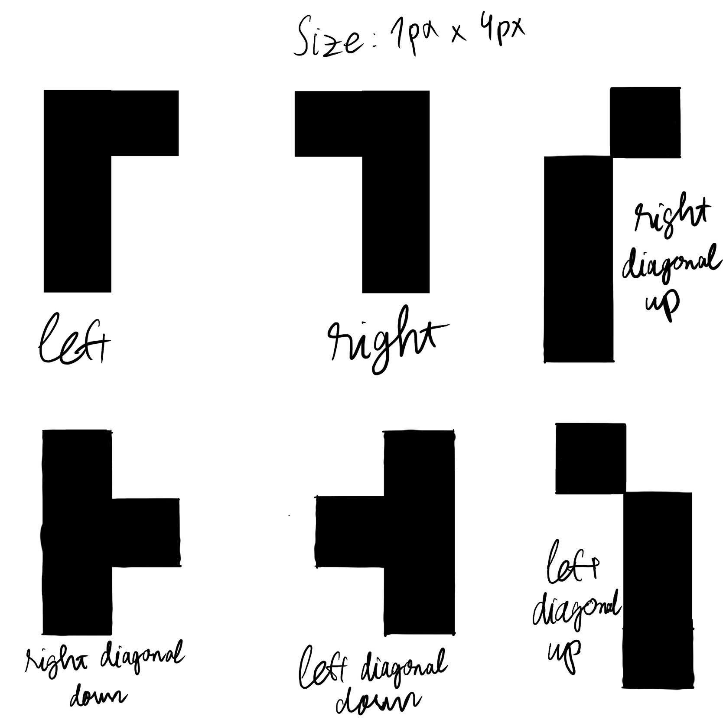

Slide 7
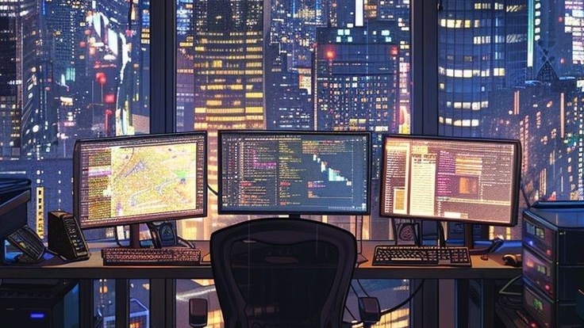
Thanks for listening
Present by Tuan Q. Tran
from GEx 2025

